Slide 1
Machine Learning Algorithms (IV)
Master´s in Applied Artificial Intelligence
Luís Ferreira
lufer@ipca.pt

Slide 2
Overview
Part I
Artificial Intelligence and Machine Learning
Foundations
Part II
Machine Learning
Part III
Machine Learning Algorithms
Parte V
Deep Learning & Neural Networks
Parte IV
Building a ML Model
Parte V
Advanced ML

Slide 3
Part III
Machine Learning Algorithms
Competencies to be acquired:
Choosing ML Algorithms
Improving models

Slide 4

Part III: MLA
Modelling
Choosing the best estimator/algorithm
  In Sklearn refers Algorithms or Machine Learning Models as “estimators”
  Classification problem - predicting a category (it will rain or not)
  Regression problem – predicting a number (the temperature)
https://scikit-learn.org/stable/tutorial/machine_learning_map/index.html

Slide 5
Part III: MLA
Model Improvement
Improving a model on data, model or parameters:
  From the data perspective:
    Can the data be improved?
    Could we collect more data (the more data, the better, usually!)
  From the model perspective
    Is there a better model?
    Can the current model be improved? (exploring hyperparameters)
Notes:
141

Slide 6
Part III: MLA
Model Improvement
Hyperparameters versus Parameters
  Parameters (internal variables – learned during th training, from the data)
    correspond to patterns that model found in data
  Hyperparameters (external settings for training strategy, before training )
    are model settings that we can try to adjust
Notes:
141

Slide 7
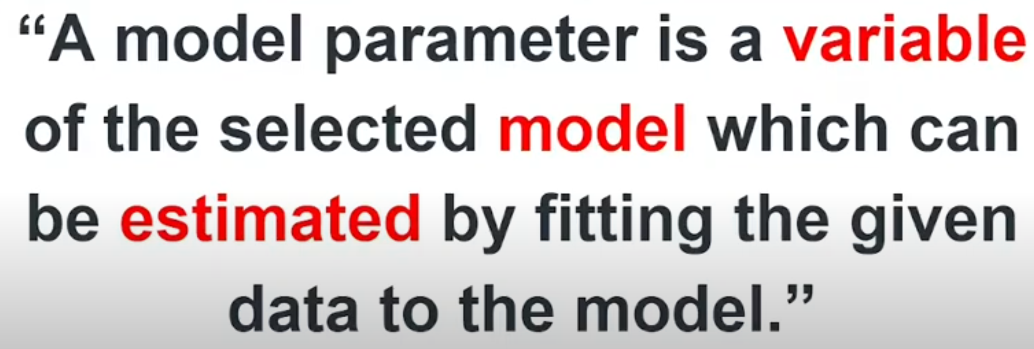
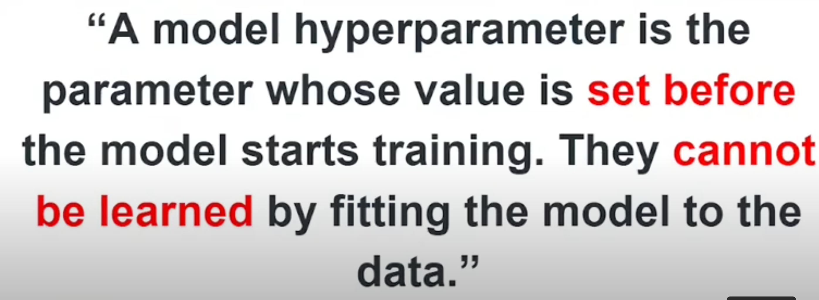
Part III: MLA
Model Improvement
Hyperparameters versus Parameters
  Parameters (internal model variables)
    correspond to patterns that model found in data
  Hyperparameters (external settings for training strategy)
    are model settings that we can try to adjust
Example:
Linear Regression: y = m*x + c
m (slope) and c (intercept)
are the model parameters
Notes:
141

Slide 8
Part III: MLA
Model Improvement
How to manipulate
  Manually
  Assisted:
    Randomly with RandomSearchCV
    Exhaustively with GridSearchCV
Notes:
141

Slide 9
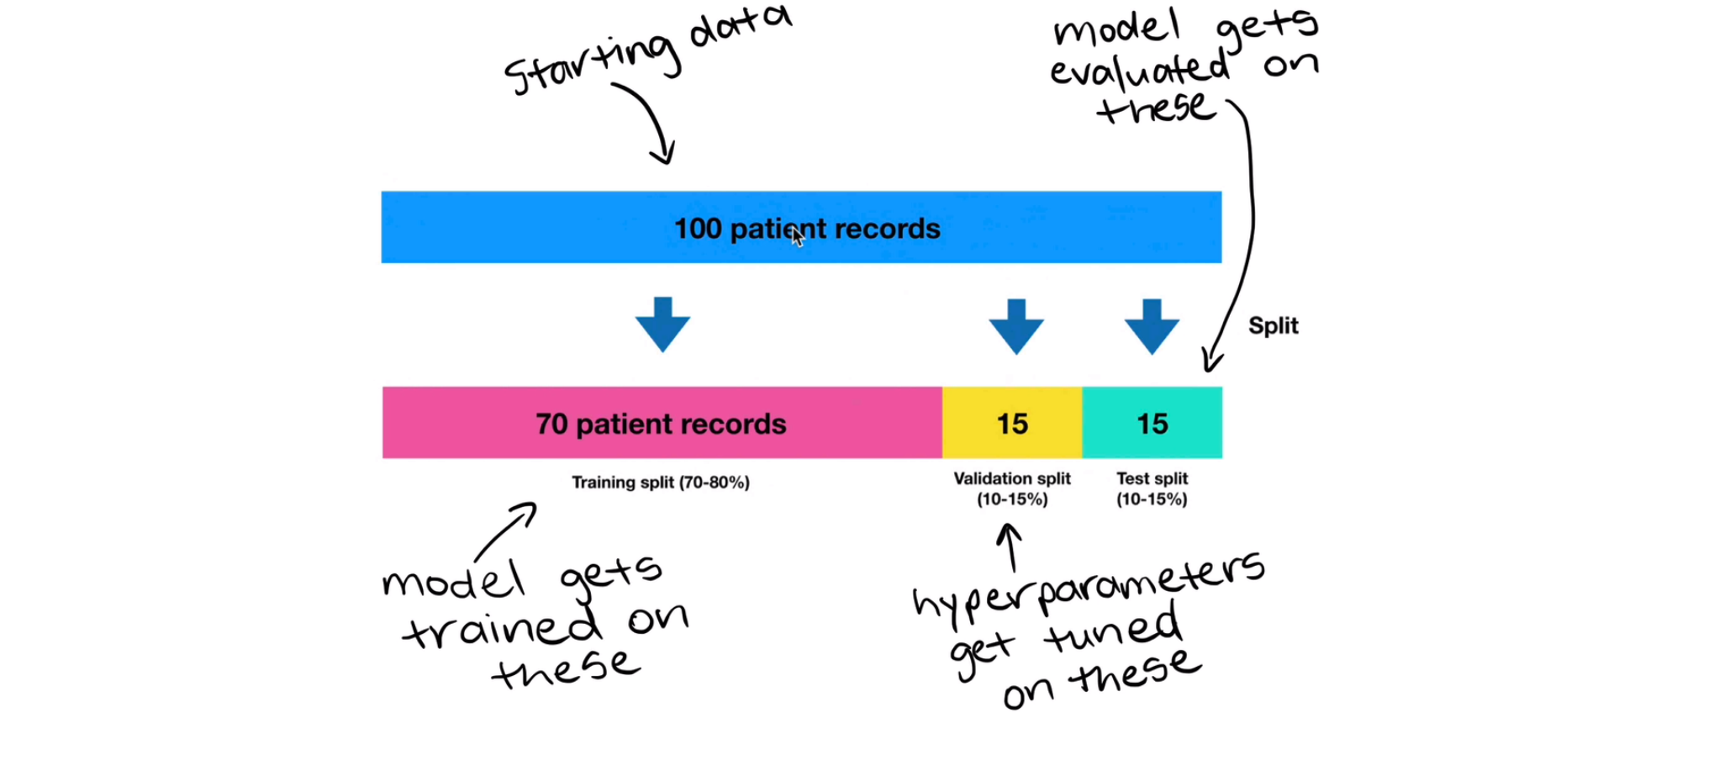
Part III: MLA
Model Improvement
Train a model on the training data.
(Try to) improve the model's hyperparameters on the validation set.
Evaluate the model on the test set.
Manipulating (hyper)parameters by hand
  Create a new dataset part (Validation Dataset)
  Hyperparameters are tuned on Validation Set
Notes:
141

Slide 10
Part III: MLA
Model Improvement
X
y
y_train
X_test
Y_test
X_train
X_train, X_test, y_train, y_test = train_test_split(X,y,test_size=0.2)
rf = RandomForestClassifier()
rf.fit(X_train,y_train)
rf.score(X_test,y_test) #internally use accuracy_score()
…
y_preds=rf.predict(X_test)
accuracy_score(y_test,y_preds) #equal to score(), if normalized
Notes:
141

Slide 11
Part III: MLA
Model Improvement
X
y
y_train
X_valid
y_valid
X_test
X_train
Y_test
# Training and test split (70% train, 30% test)
X_train, X_test, y_train, y_test = train_test_split(X, y, test_size=0.3)
# Create validation and test split by splitting testing data in half (30% test -> 15% validation, 15% test)
X_valid, X_test, y_valid, y_test = train_test_split(X_test, y_test, test_size=0.5)
clf = RandomForestClassifier()
clf.fit(X_train, y_train)
y_preds = clf.predict(X_valid)
accuracy_score(y_valid,y_preds)
Notes:
141

Slide 12
Part III: MLA
Model Improvement
Manipulating hyperparameters by hand
  Check existing hyperparameters for the selected model
  Example:
    https://scikit-learn.org/stable/modules/generated/sklearn.ensemble.RandomForestClassifier.html
  Change hyperparameters’ values
  Experiment incrementally
Notes:
141

Slide 13
Part III: MLA
Model Improvement
Manipulating hyperparameters by hand
  Check existing hyperparameters for the selected model
  Example:
    https://scikit-learn.org/stable/modules/generated/sklearn.ensemble.RandomForestClassifier.html
  Change hyperparameters’ values
  Experiment incrementally
model = RandomForestClassifier(n₁=v₁, n₂=v₂,…,n_{i}=v_{i}) #new instance
model.fit(X_train, y_train) #train
model.score(X_test, y_test) #evaluate
ATTENTION: There is RandomForestRegressor() for Regression Problems – See 7_Modelling_Regression.ipynb
Notes:
141

Slide 14
Part III: MLA
Model Improvement
Manipulating hyperparameters by hand
  Check existing hyperparameters for the selected model
  Example:
    https://scikit-learn.org/stable/modules/generated/sklearn.ensemble.RandomForestClassifier.html
Change hyperparameters’ values
Experiment incrementally
model = RandomForestClassifier( #new instance
n_estimators=120,
max_depth=10
)
model.fit(X_train, y_train) #train
model.score(X_test, y_test) #evaluate
Notes:
141

Slide 15
Part III: MLA
Model Improvement
Manipulating hyperparameters by hand
  Check existing hyperparameters for the selected model
  Example:
    https://scikit-learn.org/stable/modules/generated/sklearn.ensemble.RandomForestClassifier.html
Change hyperparameters values
Experiment int incrementally
for i in range(100, 200, 10):
model = RandomForestClassifier(n_estimators=i) #new instance
model.fit(X_train, y_train) #train
model.score(X_test, y_test) #evaluate
Notes:
141

Slide 16
Part III: MLA
Model Improvement
Manipulating hyperparameters by hand
  Check existing hyperparameters for the selected model
  Example:
    https://scikit-learn.org/stable/modules/generated/sklearn.ensemble.RandomForestClassifier.html
  Change hyperparameters values
  Experiment int incrementally
  Force cross-validation (k-fold cross-validation)
Notes:
141

Slide 17
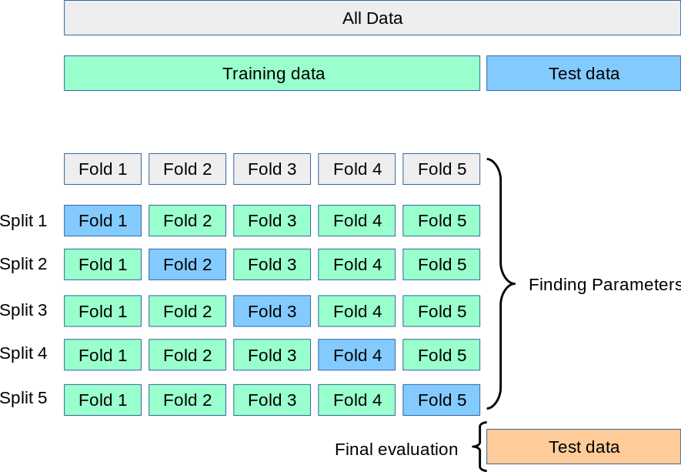
Part III: MLA
Modell Improvement
Manipulating hyperparameters by hand
  Check existing hyperparameters for the selected model
  Example:
    https://scikit-learn.org/stable/modules/generated/sklearn.ensemble.RandomForestClassifier.html
  Change hyperparameters values
  Experiment int incrementally
  Force cross-validation (k-fold cross-validation)
Source: https://scikit-learn.org/stable/modules/cross_validation.html
Notes:
141

Slide 18
Part III: MLA
Modell Improvement
Manipulating hyperparameters by hand
  Check existing hyperparameters for the selected model
  Example:
    https://scikit-learn.org/stable/modules/generated/sklearn.ensemble.RandomForestClassifier.html
  Change hyperparameters values
  Experiment int incrementally
  Force cross-validation (k-fold cross-validation)
IMPORTANT TO READ
https://scikit-learn.org/stable/modules/cross_validation.html
Source: https://scikit-learn.org/stable/modules/cross_validation.html
Notes:
141

Slide 19
Part III: MLA
Modell Improvement
Remember: The purpose of cross-validation is model checking, not model building
To build, see about “bootstrap aggregation or bagging”
https://machinelearningmastery.com/train-final-machine-learning-model/
Manipulating hyperparameters by hand
  Check existing hyperparameters for the selected model
  Example:
    https://scikit-learn.org/stable/modules/generated/sklearn.ensemble.RandomForestClassifier.html
Change hyperparameters values
Experiment int incrementally
Force cross-validation
for i in range(100, 200, 10):
model = RandomForestClassifier(n_estimators=i) #new instance
model.fit(X_train, y_train) #train
#model.score(X_test, y_test) #evaluate single
cross_val_mean = np.mean(cross_val_score(model, X, y, cv=5)) #evaluate several
(ATTENTION: don’t apply cross_vali_score over time series data)
Notes:
Technique called bootstrap aggregation (usually shortened to 'bagging’): use model instances produced in a way similar to cross-validation to build up an ensemble model

Slide 20
Part III: MLA
Modell Improvement
Remember: The purpose of cross-validation is model checking, not model building
To build, see about “bootstrap aggregation or bagging”
https://machinelearningmastery.com/train-final-machine-learning-model/
Manipulating hyperparameters by hand
  Check existing hyperparameters for the selected model
  Example:
    https://scikit-learn.org/stable/modules/generated/sklearn.ensemble.RandomForestClassifier.html
Change hyperparameters values
Experiment int incrementally
Force cross-validation
for i in range(100, 200, 10):
model = RandomForestClassifier(n_estimators=i) #new instance
model.fit(X_train, y_train) #train
#model.score(X_test, y_test) #evaluate single
cross_val_mean = np.mean(cross_val_score(model, X, y, cv=5)) #evaluate several
(ATTENTION: don’t apply cross_vali_score over time series data)
cross_val_score works without prior model fitting
Notes:
Technique called bootstrap aggregation (usually shortened to 'bagging’): use model instances produced in a way similar to cross-validation to build up an ensemble model

Slide 21
Part III: MLA
Modell Improvement
Remember: The purpose of cross-validation is model checking, not model building
To build, see about “bootstrap aggregation or bagging”
https://machinelearningmastery.com/train-final-machine-learning-model/
Manipulating hyperparameters by hand
  Check existing hyperparameters for the selected model
  Example:
    https://scikit-learn.org/stable/modules/generated/sklearn.ensemble.RandomForestClassifier.html
Change hyperparameters values
Experiment int incrementally
Force cross-validation
IMPORTANT TO READ for Time Series Problems:
https://scikit-learn.org/stable/modules/cross_validation.html
Notes:
Technique called bootstrap aggregation (usually shortened to 'bagging’): use model instances produced in a way similar to cross-validation to build up an ensemble model

Slide 22
Part III: MLA
Modell Improvement
How to manipulate
  Manually (Ok)
  Assisted:
    Randomly with RandomSearchCV
    Exhaustively with GridSearchCV
Notes:
141

Slide 23
Part III: MLA
Modell Improvement
Manipulating hyperparameters with RandomSearchCV
  “(…) implements a “fit” and a “score” method. It also implements “score_samples”, “predict”, “predict_proba”, “decision_function”, “transform” and “inverse_transform” if they are implemented in the used estimator(…)”
https://scikit-learn.org/stable/modules/generated/sklearn.model_selection.RandomizedSearchCV.html
Notes:
141

Slide 24
Part III: MLA
Modell Improvement
Manipulating hyperparameters with RandomSearchCV
  Create a dictionary with intended parameters/values
# Hyperparameter grid for RandomizedSearchCV
param_values = { "n_estimators": [10, 100, 200, 500, 1000, 1200], "max_depth": [None, 5, 10, 20, 30],
"max_features": ["sqrt", "log2", None],
"min_samples_split": [2, 4, 6, 8],
"min_samples_leaf": [1, 2, 4, 8]
}
param_values = {"hyperparameter_name": [values_to_randomly_try]}
https://scikit-learn.org/stable/modules/generated/sklearn.model_selection.RandomizedSearchCV.html
Notes:
141

Slide 25
Part III: MLA
Modell Improvement
Manipulating hyperparameters with RandomSearchCV
  Create a dictionary with intended parameters/values
  Configure RandomSearchCV
rfc = RandomizedSearchCV( estimator=rfc,
param_distributions=param_values,
n_iter=10, # how many models to try
cv=5, # 5-fold cross-validation
verbose=2)
Notes:
141

Slide 26
Part III: MLA
Modell Improvement
Manipulating hyperparameters with RandomSearchCV
  Create a dictiornay with intended parameters/values
rfc = RandomizedSearchCV( estimator=rfc,
param_distributions=param_values,
n_iter=10, #how many models you test
cv=5, # 5-fold cross-validation
verbose=2)
# “best_params_” variable has the best hyperparameters found
rfc.best_params_
param_values = {"hyperparameter_name": [values_to_randomly_try]}
After this process, calling `predict()` on `rfc`, will use the best hyperparameters it found.
https://scikit-learn.org/stable/modules/generated/sklearn.model_selection.RandomizedSearchCV.html
rfc_y_preds = rfc.predict(X_test)
Notes:
141

Slide 27
Part III: MLA
Modell Improvement
How to manipulate
  Manually (Ok)
  Randomly with RandomSearchCV (Ok)
  Exhaustively with GridSearchCV
Notes:
141

Slide 28
Part III: MLA
Modell Improvement
not all parameter values are tried out, but rather a fixed number of parameter settings is sampled from the specified distributions. The number of parameter settings that are tried is given by n_iter
Manipulating hyperparameters with GridSearchCV
  The main difference between `GridSearchCV` and `RandomizedSearchCV` is `GridSearchCV` searches across a grid of hyperparamters exhaustively (it will try every combination possible), where as, `RandomizedSearchCV` searches across a grid of hyperparameters randomly (stopping after `n_iter` combinations)
https://scikit-learn.org/stable/modules/generated/sklearn.model_selection.GridSearchCV.html
Notes:
141

Slide 29
Part III: MLA
Modell Improvement
Manipulating hyperparameters with GridSearchCV
  Create a simple dictionary with intended parameters/values only
  Star by using the hyperparameters’ sequence resultant from RandomSearchCV
rfc.best_params_
{
'n_estimators': 1200,
'min_samples_split': 2,
'min_samples_leaf': 2,
'max_features’: 'sqrt’,
'max_depth’: 5
}
Notes:
141

Slide 30
Part III: MLA
Modell Improvement
Manipulating hyperparameters with GridSearchCV
  Create a simpler dictionary with intended parameters/values
param_values = {"hyperparameter_name": [values_to_randomly_try]}
grid2 = { "n_estimators": [200, 1000],
  "max_depth": [30, 40],
"max_features": ["log2"],
"min_samples_split": [2, 4, 6],
"min_samples_leaf": [4]}
https://scikit-learn.org/stable/modules/generated/sklearn.model_selection.RandomizedSearchCV.html
Notes:
141

Slide 31
Part III: MLA
Modell Improvement
rfc.best_params_
{
'n_estimators': 1000,
'min_samples_split': 4,
'min_samples_leaf': 4,
'max_features': 'log2',
'max_depth': 30
}
Manipulating hyperparameters with GridSearchCV
  Create a simpler dictionary with intended parameters/values
# Hyperparameter grid for RandomizedSearchCV
param_values = { "n_estimators": [10, 100, 200, 500, 1000, 1200], "max_depth": [None, 5, 10, 20, 30],
"max_features": ["sqrt", "log2", None],
"min_samples_split": [2, 4, 6, 8],
"min_samples_leaf": [1, 2, 4, 8]
}
param_values = {"hyperparameter_name": [values_to_randomly_try]}
grid2 = { "n_estimators": [200, 1000],
  "max_depth": [30, 40],
"max_features": ["log2"],
"min_samples_split": [2, 4, 6],
"min_samples_leaf": [4]}
# Hyperparameter grid for
GridSearchCV
Notes:
141

Slide 32
Part III: MLA
Modell Improvement
Manipulating hyperparameters with GridSearchCV
  Create a simpler dictionary with intended parameters/values
grid2 = { "n_estimators": [200, 1000],
  "max_depth": [30, 40],
"max_features": ["log2"],
"min_samples_split": [2, 4, 6],
"min_samples_leaf": [4]}
gs_clf = GridSearchCV(estimator=clf,
param_grid=grid2,
cv=5, # 5-fold cross-validation
verbose=2)
gs_clf.best_aparams_
Notes:
141

Slide 33
Part III: MLA
Modell Improvement
Manipulating hyperparameters with GridSearchCV
  Create a simpler dictionary with intended parameters/values
grid2 = { "n_estimators": [200, 1000],
  "max_depth": [30, 40],
"max_features": ["log2"],
"min_samples_split": [2, 4, 6],
"min_samples_leaf": [4]}
GridSearchCV can even stay better with models’ pipeline:
See Pipeline section!!!!
gs_clf = GridSearchCV(estimator=clf,
param_grid=grid2,
cv=5, # 5-fold cross-validation
verbose=2)
gs_clf.best_aparams_
Notes:
141

Slide 34
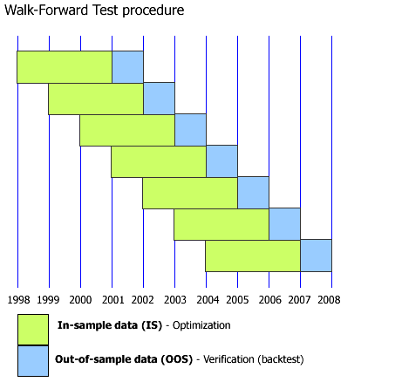
Part III: MLA
Modell Improvement
Time Series Cross-Validation
The k-fold must “behave” different,
to avoid splitting “time correlations”
Essential to respect the
chronological order to avoid data
leakage!
Explore:
  Rolling Window (Fixed Training
  Size - (recent data better)
  Expanding Window (Growing Training Set) – (old data matters)
  TimeSeriesSplit() function
https://i.sstatic.net/padg4.gif
Notes:
141

Slide 35
Part III: MLA
Modell Improvement
# Define model
model = RandomForestRegressor()
# Time Series Cross-Validation
tscv = TimeSeriesSplit(n_splits=5)
# Define hyperparameters
param_grid = {'n_estimators': [10, 50, 100]}
# GridSearchCV with TimeSeriesSplit
grid_search = GridSearchCV(model, param_grid, cv=tscv,….)
grid_search.fit(X, y)
Time Series Cross-Validation
The k-fold must “behave” different,
to avoid splitting “time correlations”
Essential to respect the
chronological order to avoid data
leakage!
Explore:
  Rolling Window (Fixed Training
  Size - (recent data better)
  Expanding Window (Growing Training Set) – (old data matters)
  TimeSeriesSplit() function
https://i.sstatic.net/padg4.gif
Notes:
141

Slide 36
Part III: MLA
Modell Improvement - Summary
Manipulating hyperparameters
  Tune hyperparameters by hand to get a feel of the data/model.
  Create a large set of hyperparameter distributions and search across them randomly with `RandomizedSearchCV`.
  Find the best hyperparameters from 2 and reduce the search space before searching across a smaller subset exhaustively with `GridSearchCV`.
Notes:
141

Slide 37
Part III: MLA
Modell Improvement - Summary
Attention:
If you want to compare and evaluate the results of model_1 and model_2, they should both be trained on the same data (e.g. X_train and y_train) and their predictions should each be made on the same data, for example:
model_1.fit(X_train, y_train)
model_1_preds = model_1.predict(X_test)
model_2.fit(X_train, y_train)
model_2_preds = model_2.predict(X_test)
Manipulating hyperparameters
  Tune hyperparameters by hand to get a feel of the data/model.
  Create a large set of hyperparameter distributions and search across them randomly with `RandomizedSearchCV`.
  Find the best hyperparameters from 2 and reduce the search space before searching across a smaller subset exhaustively with `GridSearchCV`.
Notes:
141

Slide 38
Part III: MLA
Modell Improvement
Explore
  Jupyter Notebook
  8_Model_Improvement.ipynb
Notes:
141

Slide 39
Progress
Part I
Artificial Intelligence and Machine Learning
Foundations
Part II
Machine Learning
Part III
Machine Learning Algorithms (I)
Part IV
Advanced ML (II)
Part V
Deep Learning & Neural Networks

Slide 40
References
Machine Learning. Tom M. Mitchel, McGraw-Hill, 1997
Machine Learning for Everyone
  https://vas3k.com/blog/machine_learning/
Machine Learning Tutorial
  https://www.simplilearn.com/tutorials/machine-learning-tutorial/machine-learning-steps
What is machine learning and how does it work? In-depth guide
  https://www.techtarget.com/searchenterpriseai/definition/machine-learning-ML

Slide 41
Appendices

